Slide 1
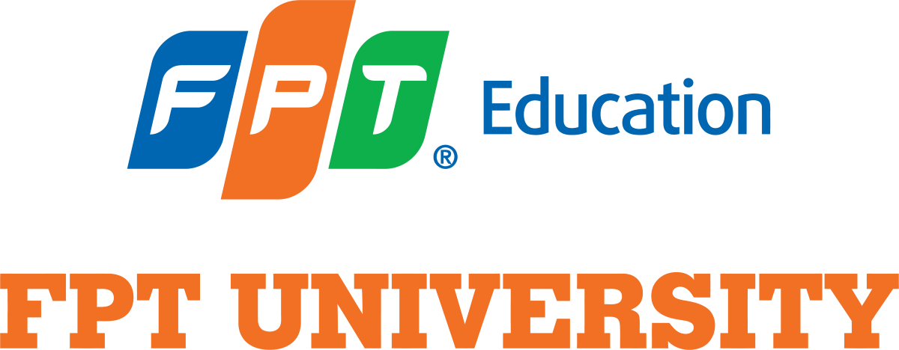
Language of Data Science

Slide 2
Objectives
Overview of Data science tooling
Tasks a data scientist need to perform
Top open source and commercial tool used for each task
How the tool overlap in functionality
Pro and cons of each tool
How tool can address the whole Data science pipeline
Language of Data Science

Slide 3
Language of Data Science
There are so many languages to use: Python, R, SQL, Scala, Java, C++, Julia, JS, Php, Go, Visual Basic,…
Python, R, and SQL are the languages that we recommend you consider first and foremost.
The language you choose to learn will depend on the things you need to accomplish and the problems you need to solve. It will also depend on what company you work for, what role you have, and the age of your existing application.
Roles in Data science:
  Business Analyst
  Database Engineer Data Analyst
  Data Engineer Data Scientist
  Research Scientist Software Engineer
  Statistician Product Manager
  Project Manager
Language of Data Science

Slide 4
Python language
Python is a powerhouse language.
It is by far the most popular programming language for Data science.
According to the 2019 Kaggle Data science and Machine Learning Survey, 75% of the over 10,000 respondents from around the world reported that they use Python on a regular basis.
Glassdoor reported that in 2019 more than 75% of Data science positions listed included Python in their job descriptions.
When asked which language an aspiring data scientist should learn first, most data scientists say Python.
Language of Data Science

Slide 5
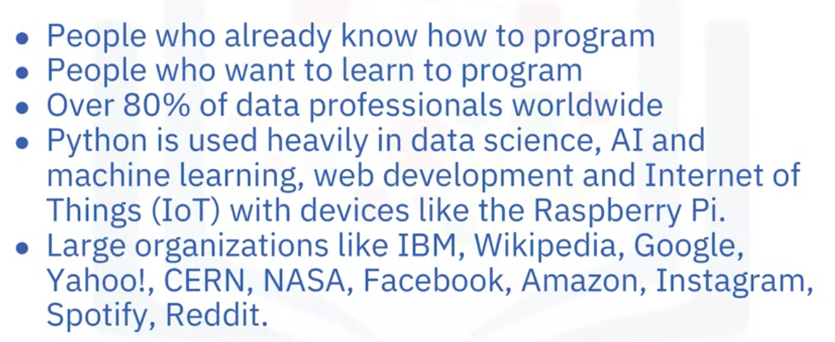
Python language
Who is Python for ?
Language of Data Science

Slide 6
Python language
What makes Python great
  General purpose language
  Large standard library
For Data science
  Scientific computing libraries like Pandas, NumPy, SciPy, and Matplotlib
  For artificial intelligence it has Pytorch, TensorFlow, Keras, and Scikit- learn
  Python can be used for Natural Language Processing using the Natural Language Toolkit
What else ? Your answer here !
Language of Data Science

Slide 7
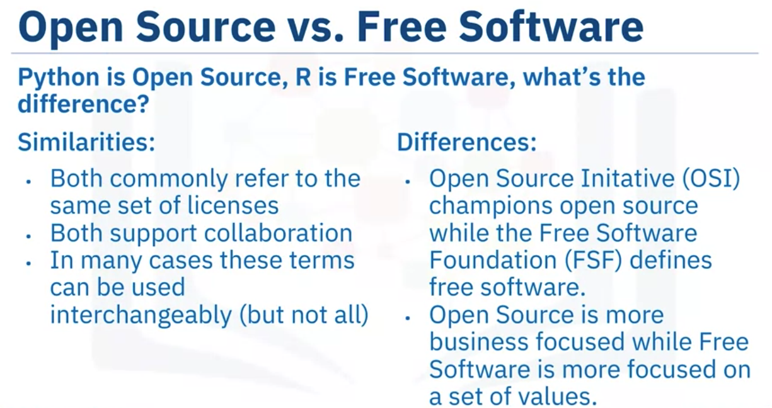
R language
Language of Data Science

Slide 8
R language
Who is R for?
  Most often used by statisticians, mathematicians, and data miners for developing statistical software, graphing, and data analysis
  The array- oriented syntax makes it easier to translate from math to code
  Most folks learn R a few year into their data science career, but R remains a welcoming language to those who don’t have a software programming background
  R is popular in academia but companies that use R include IBM, Google, Facebook, Microsoft, Bank of America, Ford, TechCrunch, Uber and Trulia
Language of Data Science

Slide 9
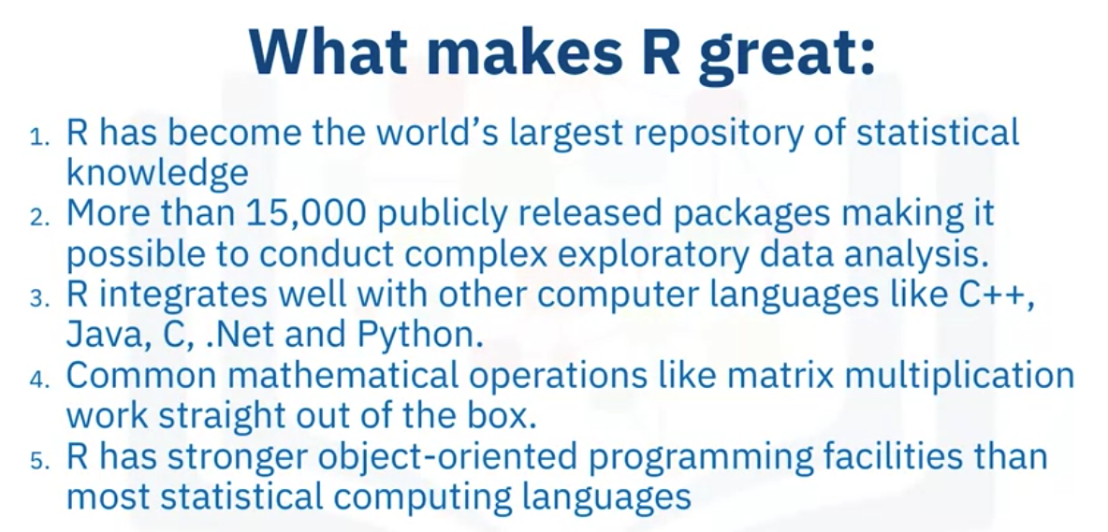
R language
Language of Data Science

Slide 10
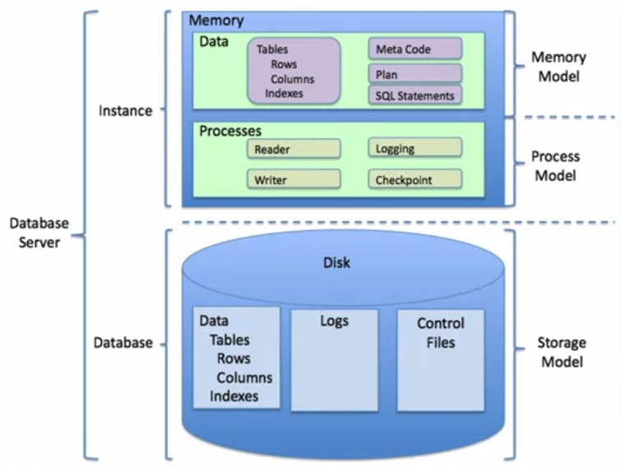
SQL language
SQL= Structured Query Language
Relational databases
Language of Data Science

Slide 11
SQL language
What makes SQL great?
  Knowing SQL will help you do many different jobs in data science, including business and data analyst, and it's a must in data engineering.
  When performing operations with SQL, you access the data directly. There's no need to copy it beforehand. This can speed up workflow executions considerably.
  SQL is the interpreter between you and the database.
  SQL is an American National Standards Institute, or "ANSI," standard, which means if you learn SQL and use it with one database, you will be able to easily apply that SQL knowledge to many other databases.
Language of Data Science

Slide 12
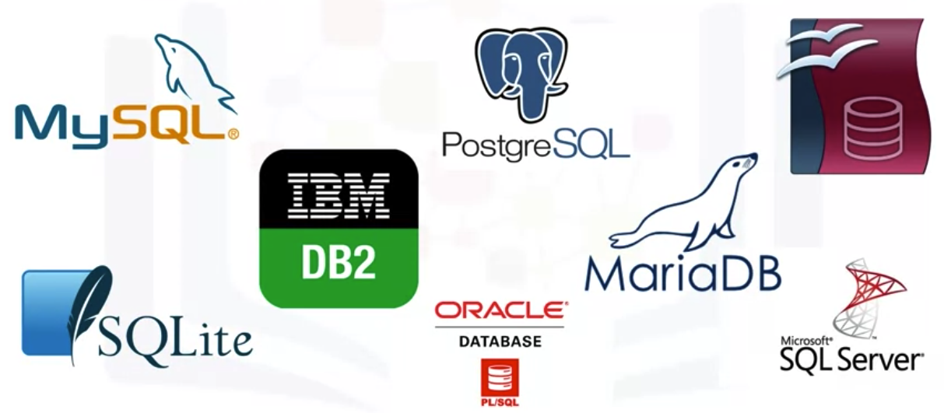
SQL language
SQL Database Avaiable
Language of Data Science

Slide 13
Summary
Overview of Data science tooling
Tasks a data scientist need to perform
Top open source and commercial tool used for each task
How the tool overlap in functionality
Pro and cons of each tool
How tool can address the whole Data science pipeline
Language of Data Science

Slide 14
Q & A
Language of Data Science

